Slide 1
Stretch your Skills: Intro to Secure & Composable Architecture w/TypeScript
Workshop 10/17/2020

Slide 2
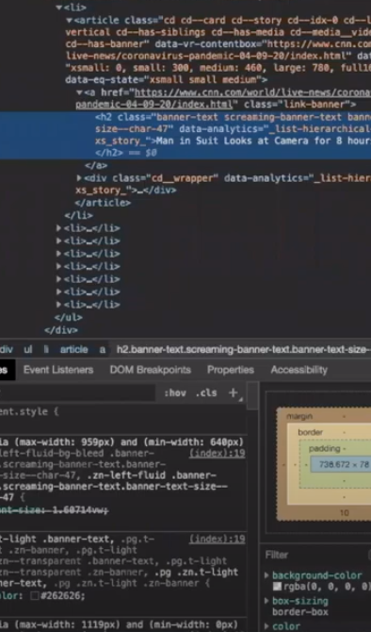
WELCOME TO
DIGITALCRAFTS
WORKSHOPS
BUILD YOUR SKILLS
BUILD YOUR CAREER
BUILD YOUR NETWORK

Slide 3
About DigitalCrafts
DigitalCrafts is the #1-rated web development bootcamp in Atlanta and Houston. Our bootcamps, now available online and in Tampa and Seattle, transform aspiring developers into full-stack software engineers.
We offer full-time and part-time bootcamps to fit your schedule. Classes start soon, so send in your application today!
digitalcrafts.com

Slide 4
IceBreakers
Name
Hometown
Fun/Interesting Fact
What made you want to learn more about TypeScript

Slide 5
Goals
Understand TypeScript syntax and differences from regular JavaScript
Understand the benefits of using TypeScript
Set up a React app and build it out using TypeScript
Understand practical patterns to organize your React app
Avoid common pitfalls when developing an app
Become aware of trends, tips, and tricks used with ReactJS and Typescript

Slide 6
Schedule
TypeScript Basics
Environment setup
Types and Syntax
Start ReactJS App using TypeScript
App Setup
Layout and Components
Lunch 12pm - 1pm
Continue ReactJS App
Finish Layout and Components
Formatting and serving data
Using TypeScript to aide structure, load data, and facilitate dynamic interaction
More Exercises
Wrap Up

Slide 7
Workflow
TypeScript basics - walk through together
Have your IDE open
React App
I will demonstrate a concept ( feel free to follow along)
An exercise will follow where you get to spend more time on the concept
I will follow up after the exercise to make sure everyone is on the same page
Notes:
Slides are just to remind everyone where we are at in the workshop. Attendees will watch instructor coding the concepts in real time and follow along.

Slide 8
TypeScript Basics: Intro, Types, & Syntax

Slide 9
Why TypeScript?
Makes debugging easier
Saves time
Enhances ability to code in an object oriented way
Supports interfaces, inheritance, generics, access - modifiers
Strongly and statically typed
Catch errors before runtime

Slide 10
History
Created by Microsoft
Made public in 2012
Popularity increased since then as more features and a faster compiler have been released.

Slide 11
What is TypeScript?
A programming language that compiles to JavaScript
Syntax of JavaScript but with types
Uses .ts file type
Compile you TypeScript using TypeScript compiler
or use Babel transpiler

Slide 12
TypeScript Compile Process
.tsconfig
TS Compiler
.ts files
.js files
Run tsc command
Output
Read tsconfig & transform code

Slide 13
Follow Along Exercises
Notes:
Follow along through TypeScript syntax and types as outlined in Workshop Template.
https://create-react-app.dev/docs/getting-started/

Slide 14

Take a Break!

Slide 15
Build a React App w/ TypeScript

Slide 16
ReactJS Setup

Slide 17
Breaking Down an App into Components

Slide 18
Exercise: Create Components
Notes:
Files for components should be created. Basic layout set up.

Slide 19
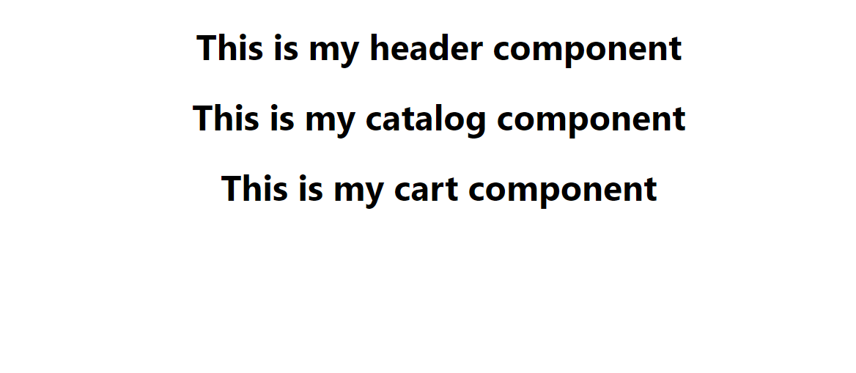

Slide 20
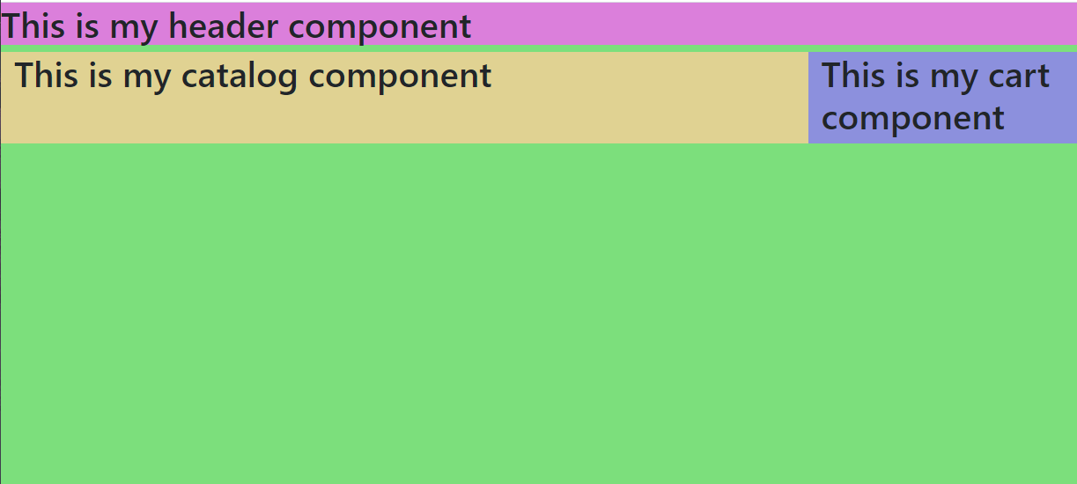

Slide 21
Variables within Components

Slide 22
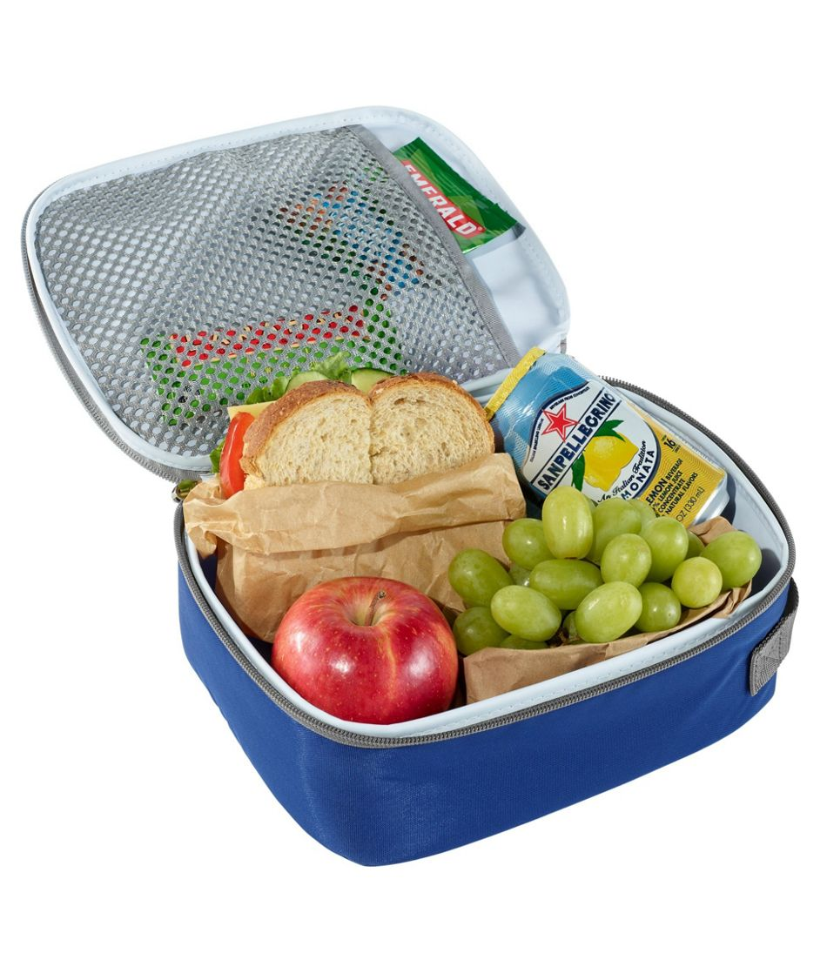
Lunchtime: Be back at 1pm

Slide 23
Exercise: Define Data Interfaces

Slide 24
Exercise: Mock Data

Slide 25
State and Props

Slide 26
Exercise: Add State to Components
Notes:
Add State to Catalog and Cart components.

Slide 27
Populate App with Data

Slide 28
Exercise: Dynamically Populate Your Catalog

Slide 29
Take a Break!

Slide 30
Exercise: Update Product Card UI

Slide 31
Passing Data Back to Parent

Slide 32
Passing Data to Siblings

Slide 33
Exercise: Update Cart to Show Items Added

Slide 34
Take a Break!

Slide 35
Update State Based on Props

Slide 36
Exercise: Update Order Summary

Slide 37
Take a Break!

Slide 38
Exercise: Update CartItem Quantities

Slide 39
More Features
Be able to add a rating to products in that show in the Catalog Product Card
Be able to add products to a favorites list from both the Catalog and the Cart

Slide 40
Continued Learning
Dynamic Catalog Search
Add a text field to the top of the Catalog component
Dynamically filter Products by the text contained on the Product's associated card
Consider what other parts of the app could become their own React components
Turn the quantity selector into its own component
Order summary could be its own component
Dynamically pass user's name to the header
Beyond the Workshop

Slide 41
The End
Thank you for joining!
Survey will be sent
Appreciate any feedback

